Slide 1
Pizza sales analysis using sql & excel
Sana Afrin

Slide 2
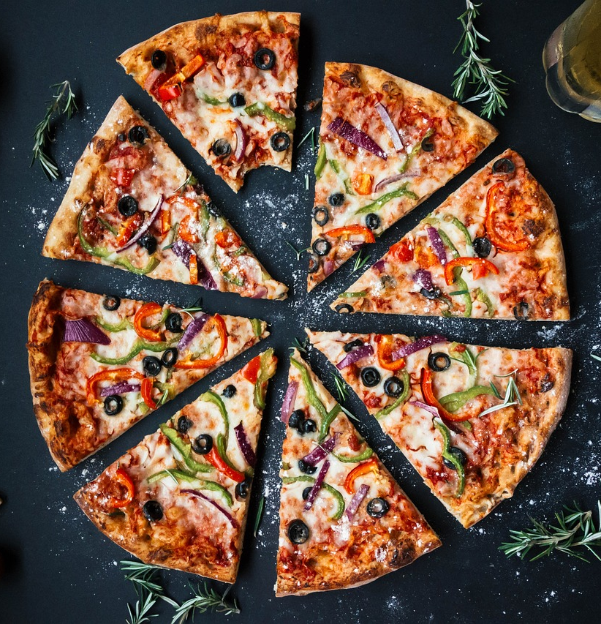
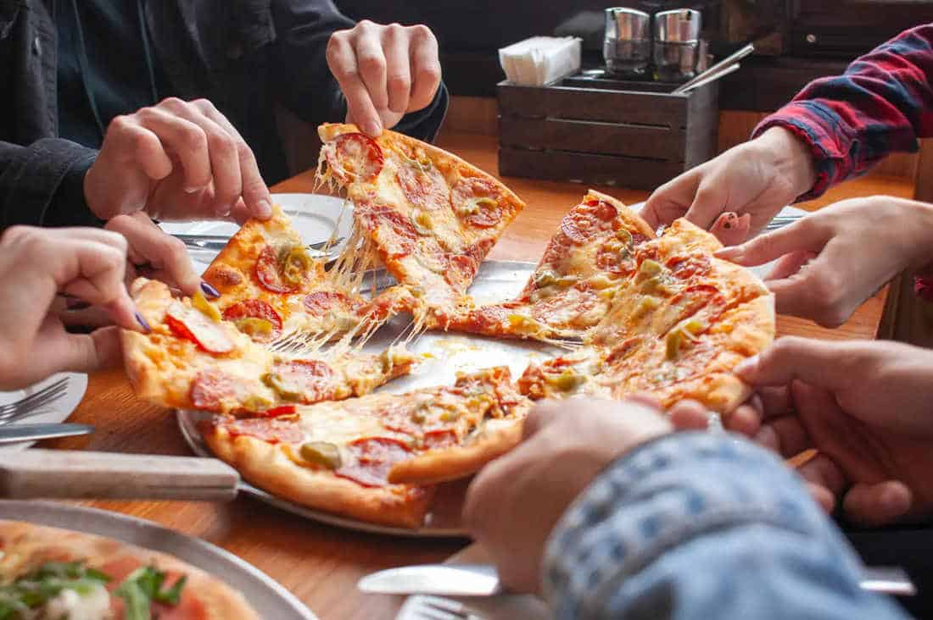
Introduction
In this analysis, we're exploring pizza sales data to uncover hidden patterns and important insights. We're focusing on key numbers that help us understand how we're doing: the total money we've made (revenue), the average amount people spend on orders, how many pizzas we've sold, the total number of orders, and the trends we see each day and hour. This report gives us a big picture of how things are going and helps us make smarter decisions for the future.

Slide 3
Approach
Understanding data and column.
Cleaned Data Using Excel
Created KPI’s using SQL.
Created Measures for Visualization

Slide 4
Tech-stAck used
SQL SERVER MANAGEMENT STUDIO : Microsoft SQL Server Management Studio is a software application developed by Microsoft that is used for configuring, managing, and administering all components within Microsoft SQL Server.
MICROSOFT EXCEL : Microsoft Excel is a spreadsheet editor developed by Microsoft for Windows, macOS, Android, iOS . It features calculation or computation capabilities, graphing tools, pivot tables, and a macro programming language called Visual Basic for Applications.

Slide 5
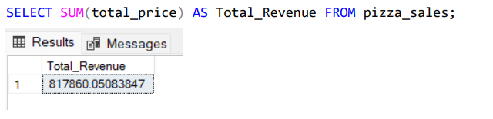
Insight and result
A. KPI’S REQUIREMENT :
We need to analyze key indicators for our pizza sales data to gain insights into our business performance. Specifically, we want to calculate the following metrics.
1. Total Revenue: The sum of the total price of all pizza orders.

Slide 6
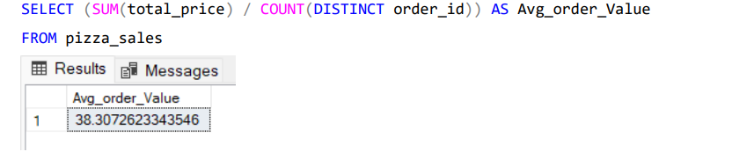
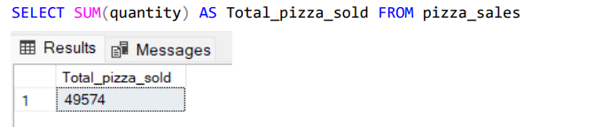
2. Average Order Value: The average Amount spent per order, calculated by dividing the total revenue by the total numbers of orders.
3. Total Pizzas Sold: The sum of the quantities of all pizzas sold.

Slide 7
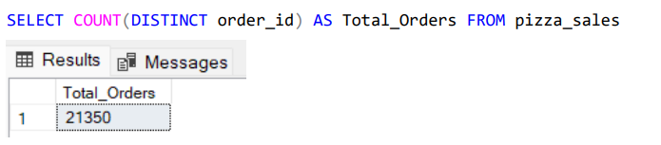
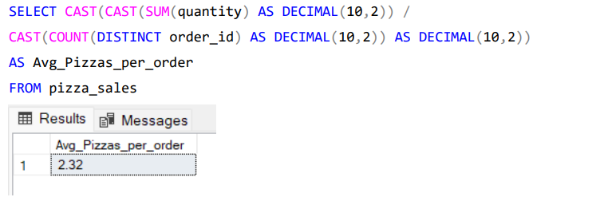
4.Total Orders: The total numbers of orders placed.
5. Average Pizzas Per Order: The average number of pizzas sold per order, calculated by dividing the total number of pizzas sold by the total number of orders.

Slide 8
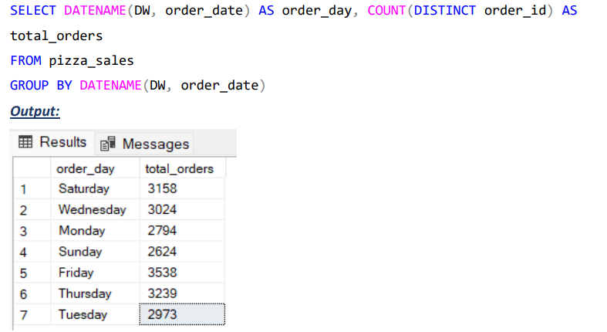
B. CHARTS REQUIREMENT: We would like to visualize various aspects of our pizza sales data to gain insights and understand key trends. We have identifies the following requirements for creating charts:
1. Daily Trend for Total Orders : Create a bar chart that displays the daily trend of total orders over a specific time period. This chart will help us identify any patterns or fluctuations in order volume on a daily basis.
Daily Trend for Total Orders

Slide 9
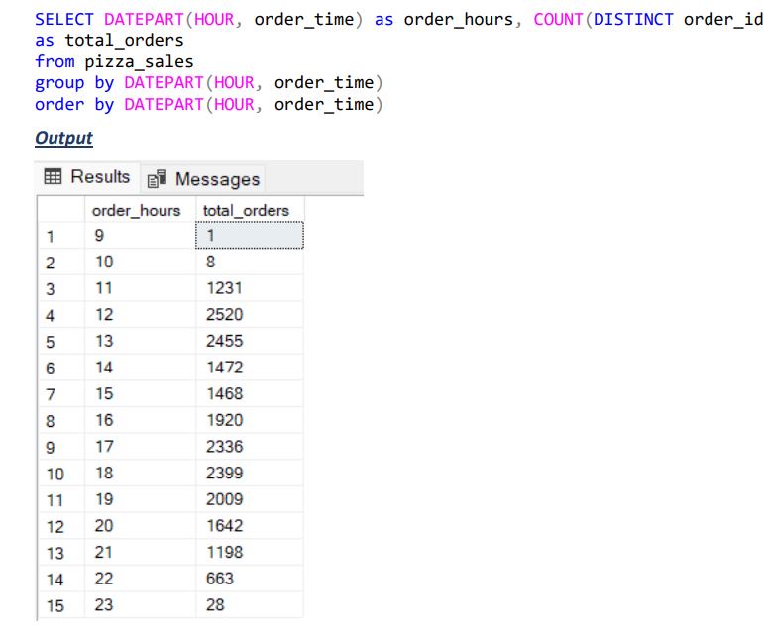
2. Hourly Trend for Total Orders : Create a line chart that illustrates the hourly trend of Total Orders throughout the day. This chat will allow us to identify peak hours or periods of high order activity.
Hourly Trend for Total Orders

Slide 10
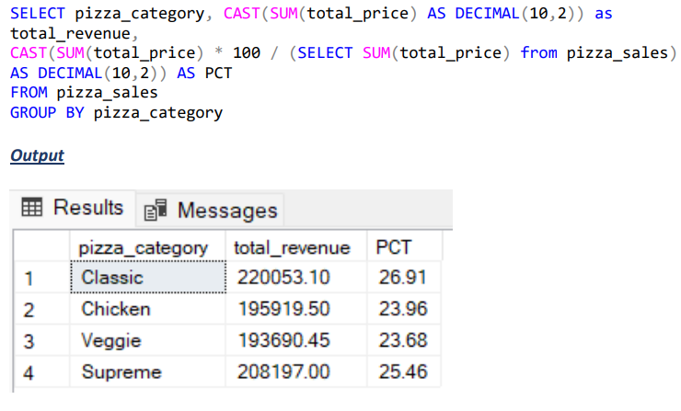
3. Percentage of Sales by Pizza Category : Create a pie chart that shows the distribution of sales across different Pizza categories. This chart will provide insights into the popularity of various Pizza categories and their contribution to overall sales.

Slide 11
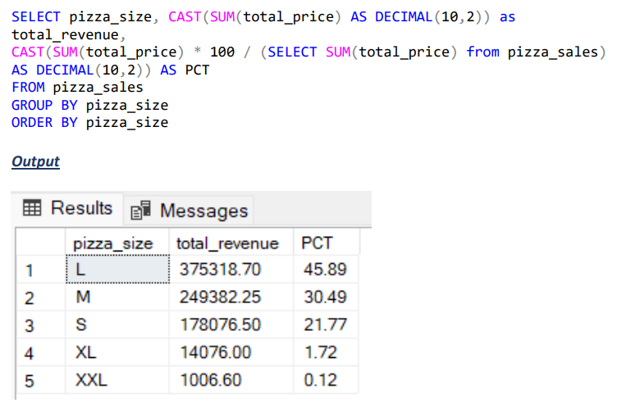
4. Percentage of Sales by Pizza Size : Generate a pie chart that represents the percentage of sales attribute to different pizza sizes. This will help us understand customer preferences for pizza sales and their impact on sales.

Slide 12
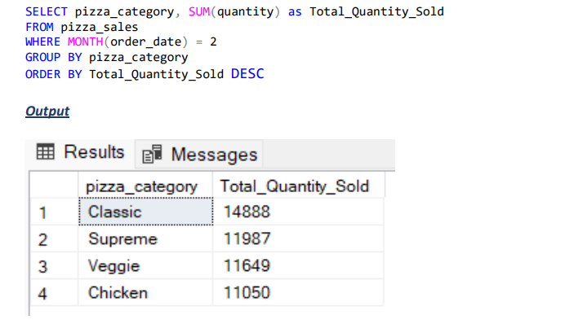
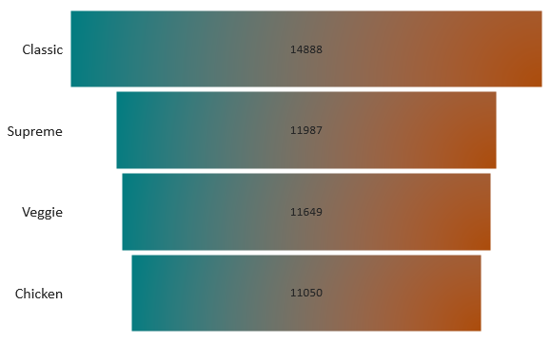
5. Total Pizzas Sold by Pizzas Category : Create a funnel chart that presents the total number of pizzas sold for each pizza category. This chart will allow us to compare the sales performance of different pizza categories.

Slide 13
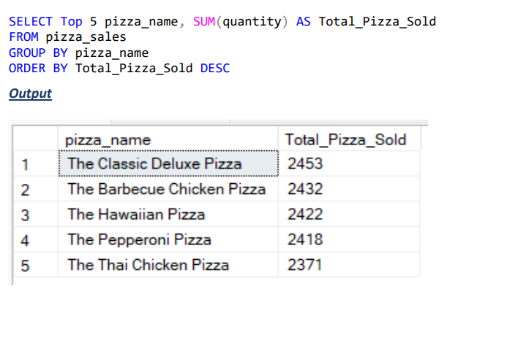
6. Top 5 Best Sellers by Total Pizzas Sold : Create a bar chart highlighting the top 5 best-selling pizzas based on the total number of pizzas sold. This chart will help us identify the most popular pizza options.

Slide 14
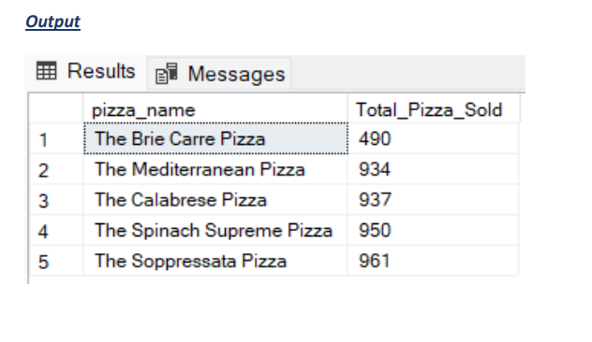
7. Bottom 5 Worst Sellers by Total Pizzas sold : Create a bar chart showcasing the bottom 5 worst selling pizzas based on the total number of pizza sold . This chart will enable us to identify under performing or less popular pizza options.

Slide 15
Key insights
The sum of the total price of all pizza orders is 817860 Rs.
The average Amount spent per order is 38.30 RS.
The sum of the quantities of all pizzas sold is 49574.
The total numbers of orders placed is 21350.
The average number of pizzas sold per order is 2.32.
On Thursday and Friday, Orders are highest.
There are maximum orders from 12:00 PM-01:00 PM & after 04:00 PM-08:00PM .

Slide 16
Classic Category contributes to maximum sales & total order.
Large size pizzas contributes to maximum sales.
Classic Deluxe & Chicken pizzas are the Best seller & revenue generators.
The Brie Carre is at the bottom in both orders and revenue.

Slide 17
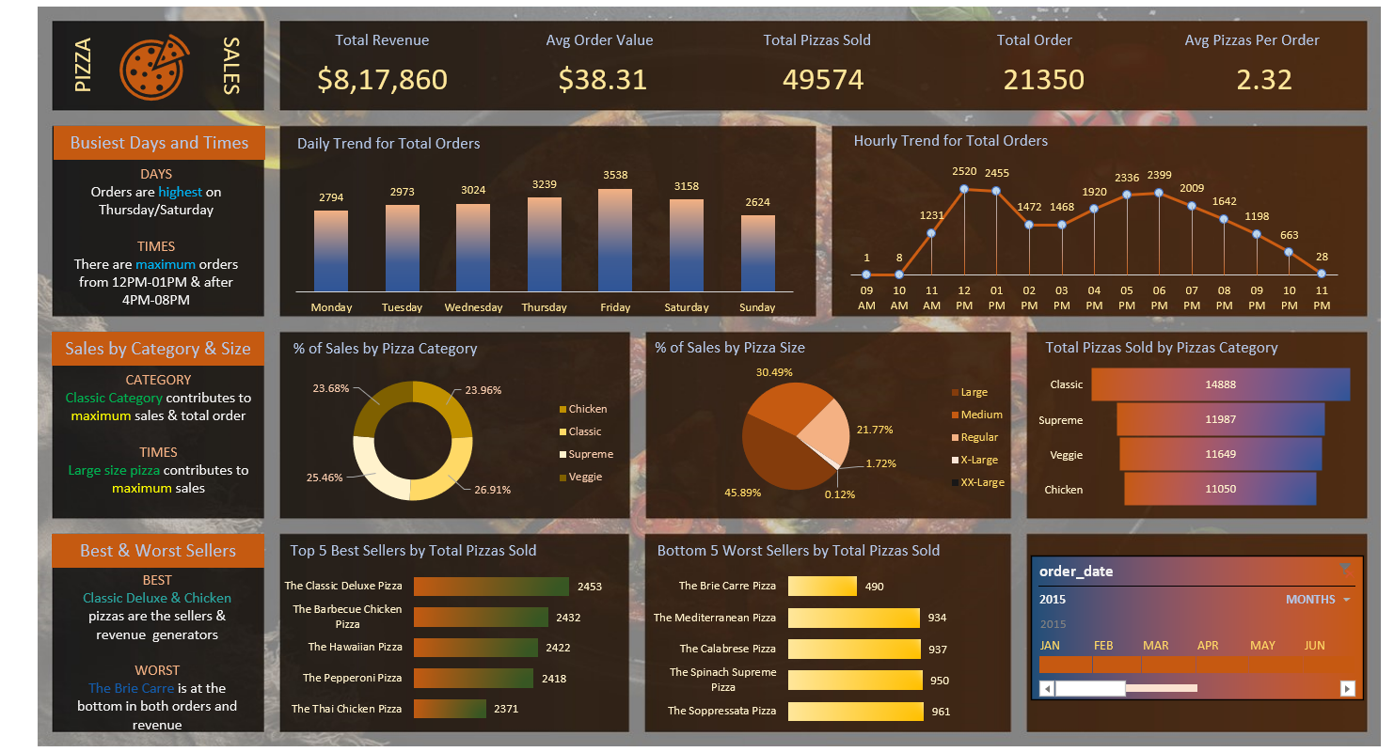
dashboard

Slide 18
THANK YOU!!!

